Slide 1


Stall Detection
ADVANCED EV3 PROGRAMMING LESSON
By Droids Robotics and Hoosier Girlz

Slide 2
Lesson Objectives
Learn what stall detection is and why it is useful
Learn how stall detection can help your robot recover from failures
Learn how to move on the next block when your robot is stalled
Prerequisites: Math Blocks, Data Wires, Logic Blocks, Loops, Move Block Lesson

Slide 3
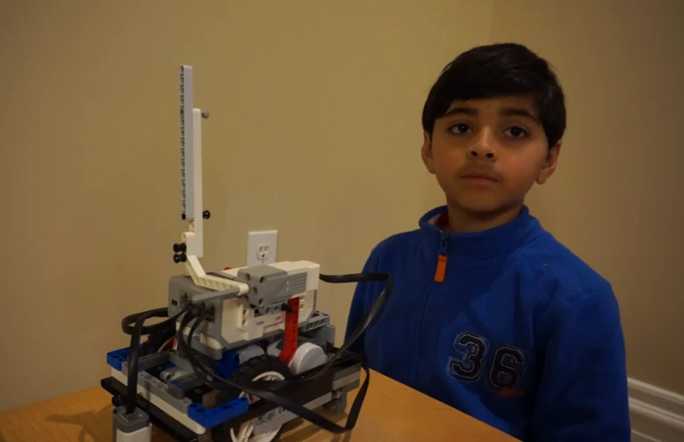
What is Stall Detection and Why Use It?
Stall detection is a program that stops your motor when the motor gets stuck
If you are an FLL team, you usually have to grab your robot and get a touch penalty if your robot stalls
When you use stall detection techniques, your robot will move on to the next program block
In the video, the robot needs to move the arm down before it says “Good job”. However, if the motor stalls, it will never say “Good job.”
Click on Video to learn
about Stall Detection

Slide 4
Move Degrees vs. Move Seconds
In our lesson on Move Blocks (Intermediate tab), we said that if you use Move Degrees, your motor may get stuck
We told you that Move Seconds helps avoid stalls, but is not as accurate
Are these the only choices?
How can you use Move Degrees and prevent stalls?
We show you how in this lesson

Slide 5
Requirements
In this lesson, you will need an arm connected to a motor
We have set our code to use a medium motor connected to motor A – this can be changed to suit your team’s needs
Follow along using the EV3 Code provided. Start with Step 1

Slide 6
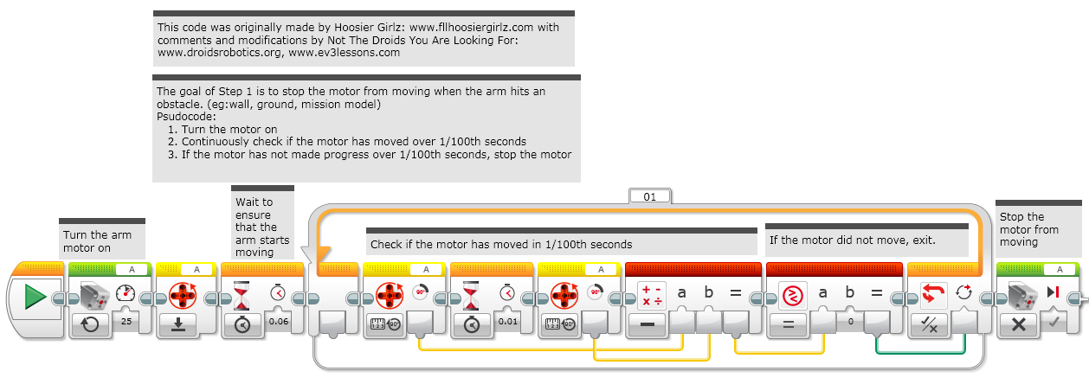
Step 1: Move Until Stall

Slide 7
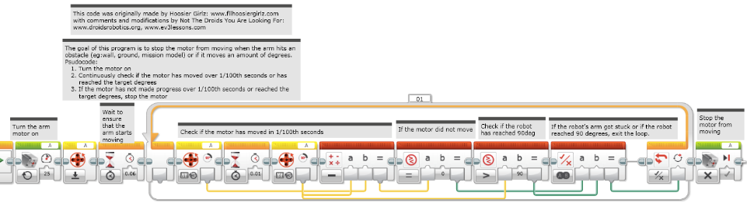
Step 2a: Move Degrees + Stall Detection

Slide 8
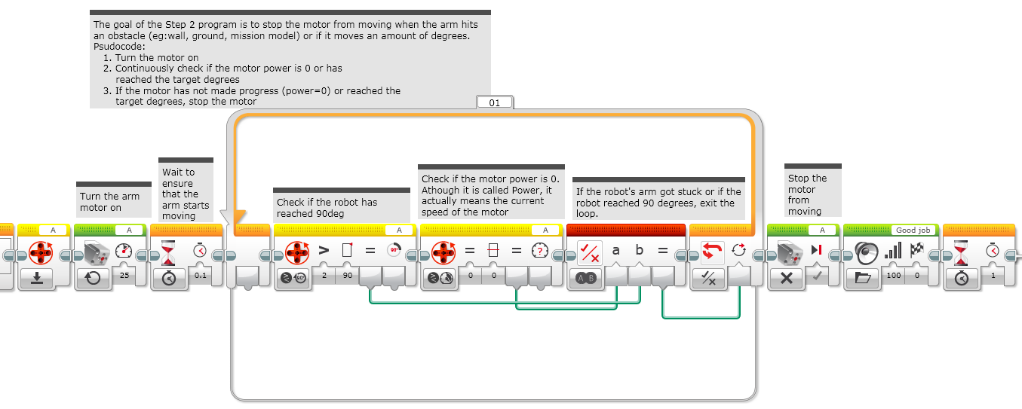
Step 2b: Alternate Move Degrees + Stall Detection
These blocks are just for the video

Slide 9
Discussion Guide
What is a stall? Ans. When you motor gets stuck and the program never moves on to the next block.
Why is stall detection useful? Ans. When the robot stalls, it gives up on that block of code and moves on to the next block of code

Slide 10

Credits
This tutorial was created by Sanjay Seshan and Arvind Seshan from Droids Robotics.
The Code was created by both Hoosier Girlz and Droids Robotics.
Step 1 and 2a by www.fllhoosiergirlz.com
Step 2a and 2b by www.droidsrobotics.org
More lessons at www.ev3lessons.com
This work is licensed under a Creative Commons Attribution-NonCommercial-ShareAlike 4.0 International License.

